Slide 1
Quantitative Methods
Geog3006

Slide 2
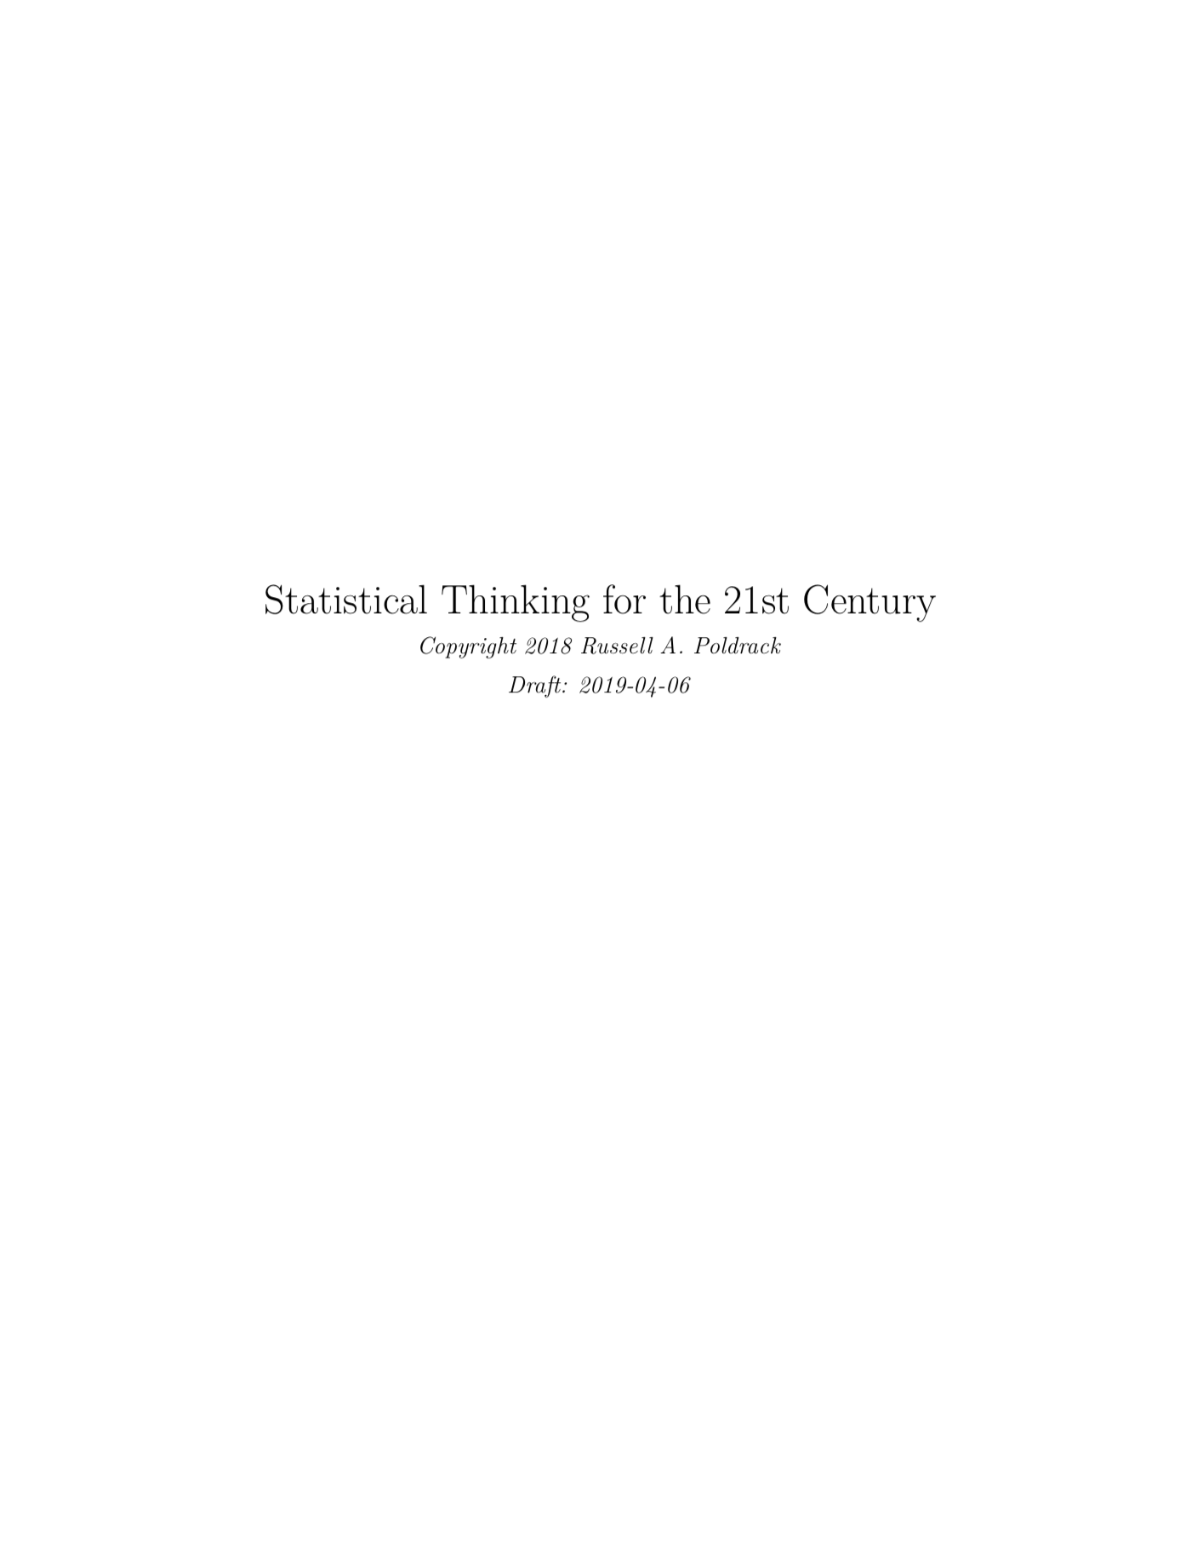
Book 1
Freely available:
https://statsthinking21.github.io/statsthinking21-core-site/StatsThinking21.pdf

Slide 3
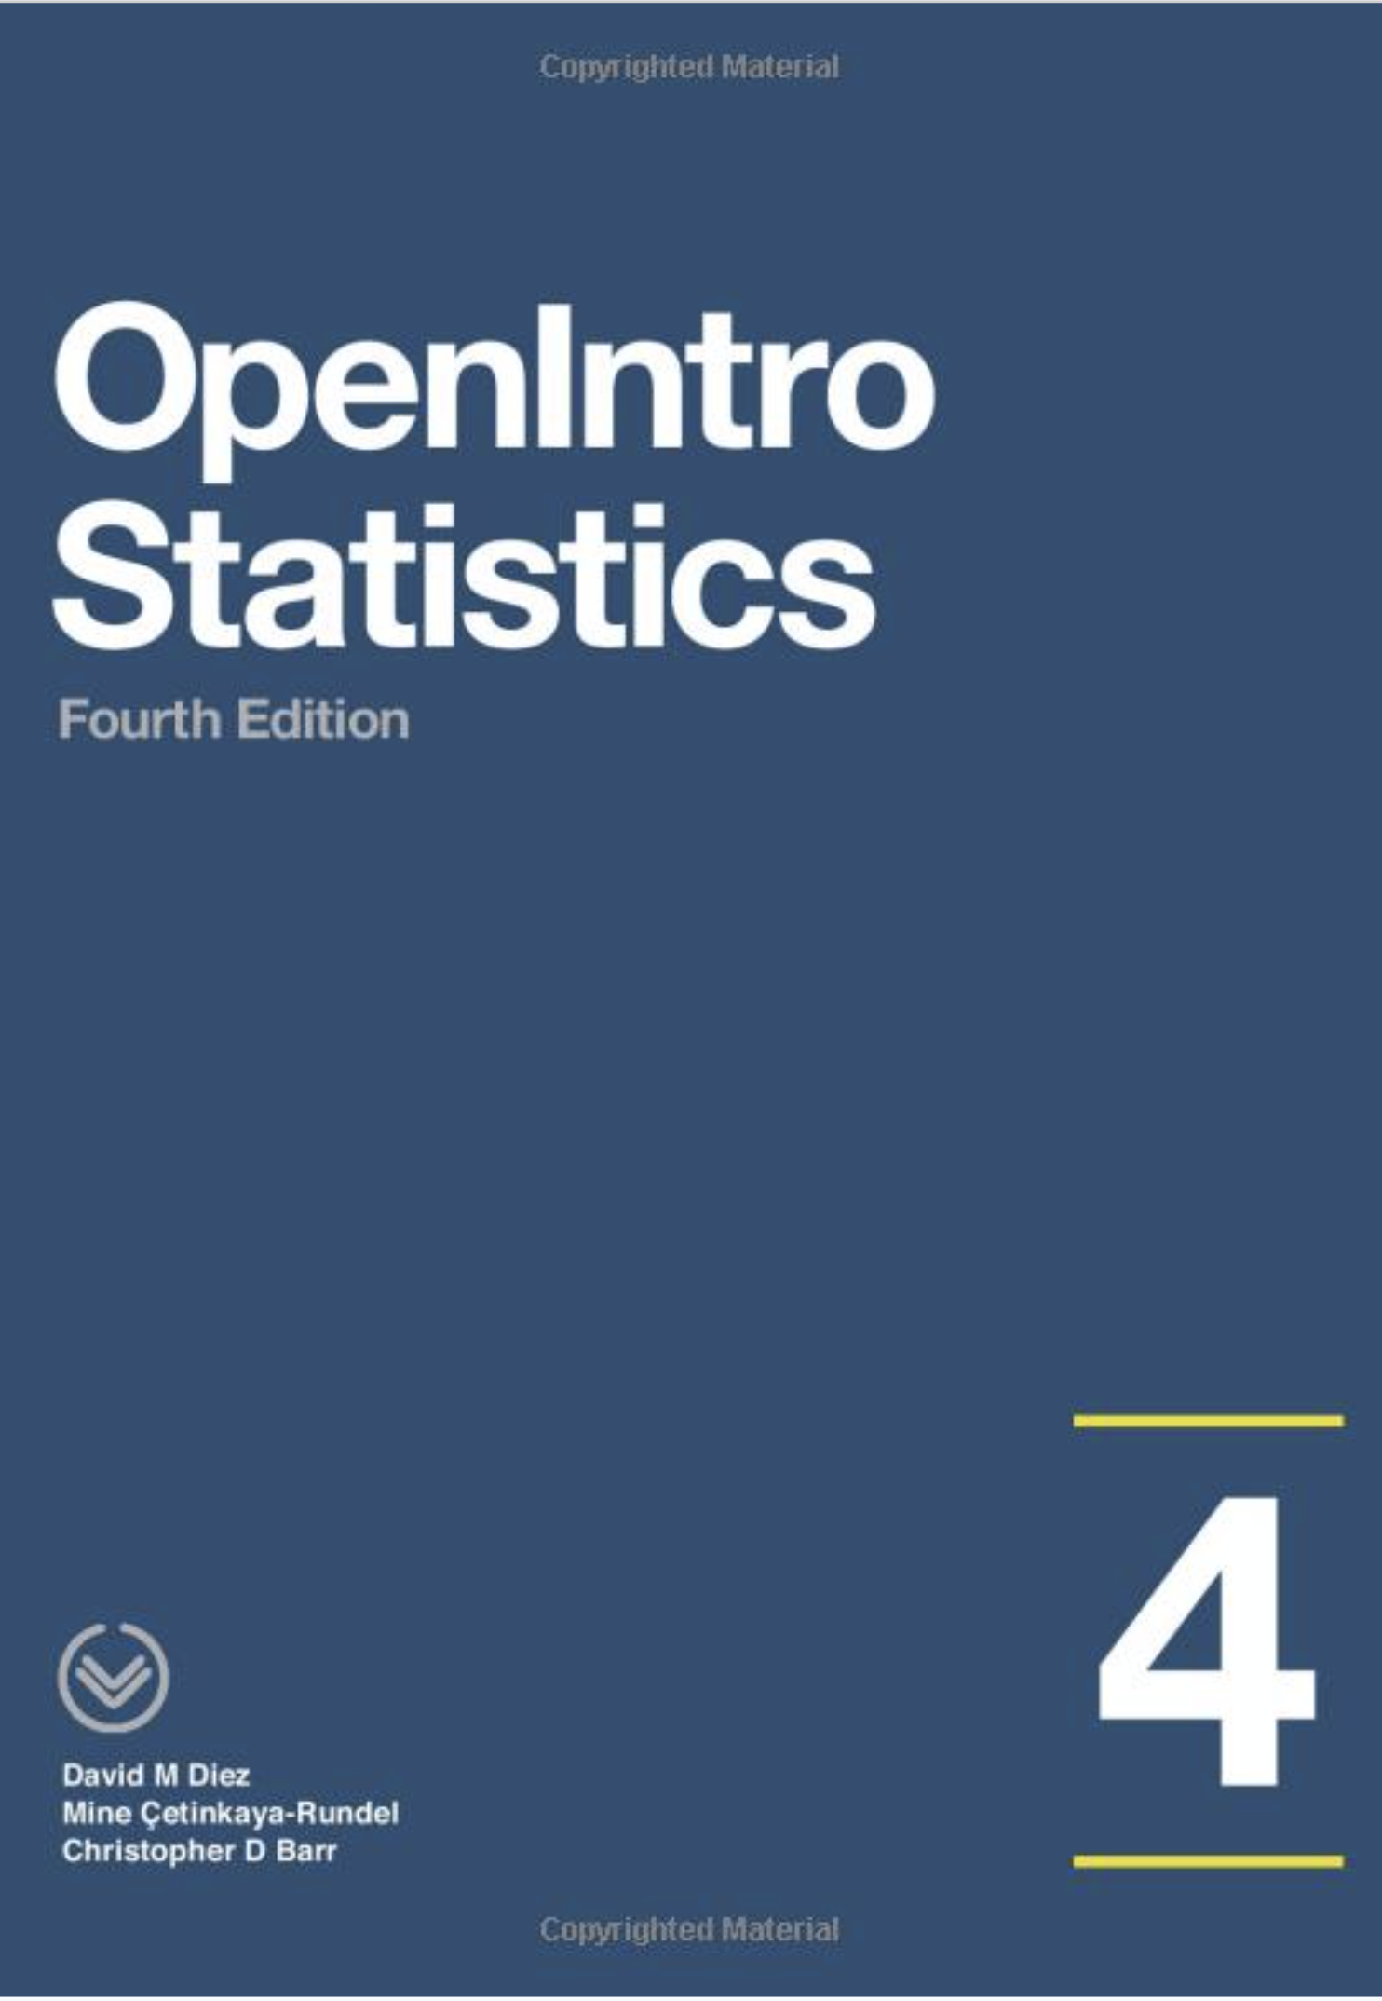
Book 2
Freely available download (you may donate):
https://www.openintro.org/stat/textbook.php
Notes:
This course is radically different than how this course have been thought in previous semesters. It is now primarily a traditional introductory course in statistics.
In the
Covers the statistics

Slide 4

Book 3
Freely available at:
https://r4ds.had.co.nz
Notes:
No longer will the course be based on SPSS. From now on the course will be based on the programming language of R.
R is what is preferred by statisticians and data scientists.
It is a programming language, which means that it has a somewhat higher learning curve than more traditional menu-based software, but no need to despair.
Benjamin Cretois, computer labs

Slide 5

Companies using R

Slide 6
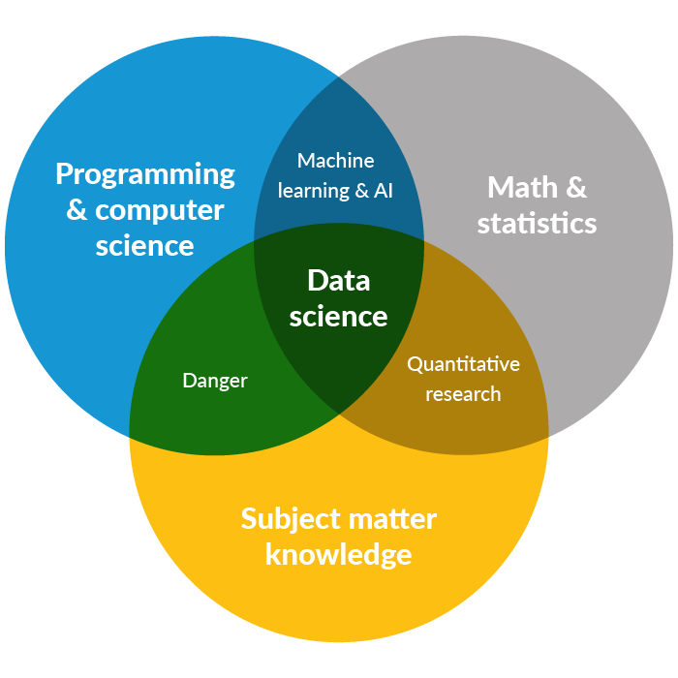
Quantitative analysis today

Slide 7

GEOG3006 & the use of
Benjamin Cretois
PhD Candidate NTNU & NINA

Slide 8

What are R and Rstudio?

Slide 9
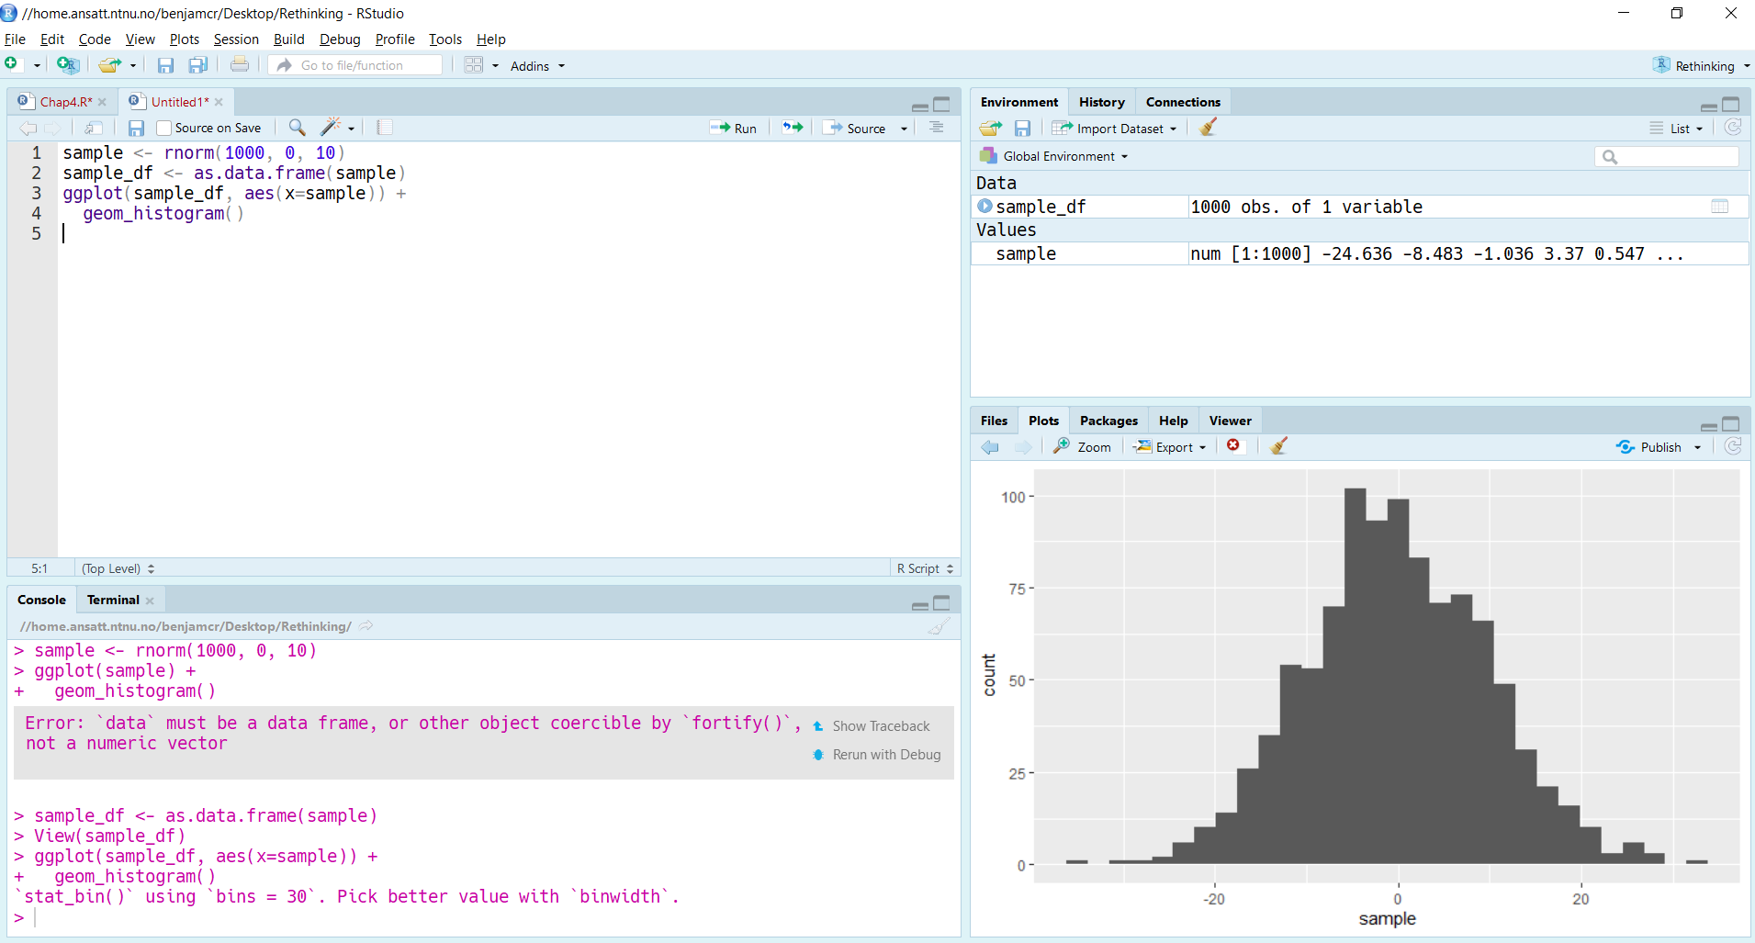
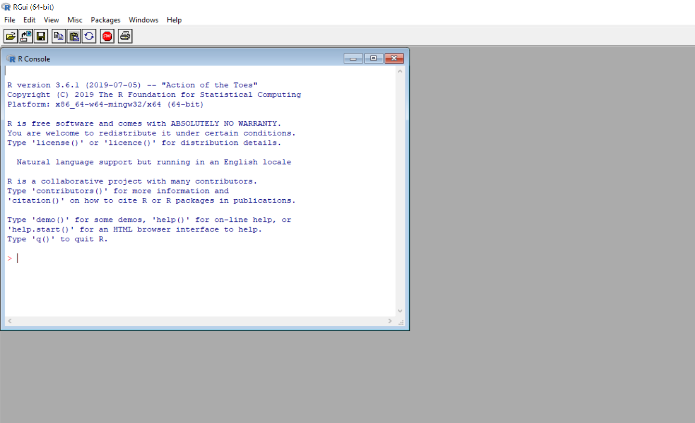

Slide 10




Advantages of R over other software
R is the most used programming language for statistics
R is free and open source
A very active and creative community
R produces high quality graphics …

Slide 11
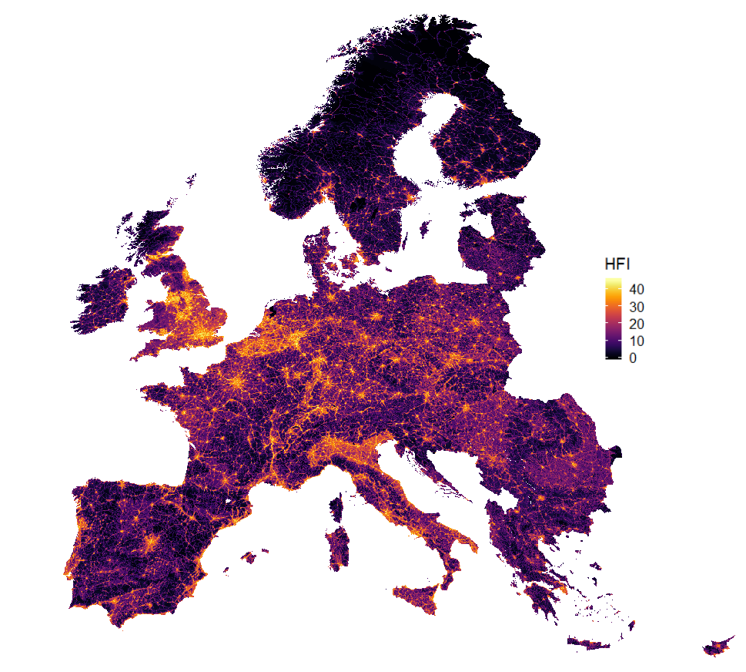
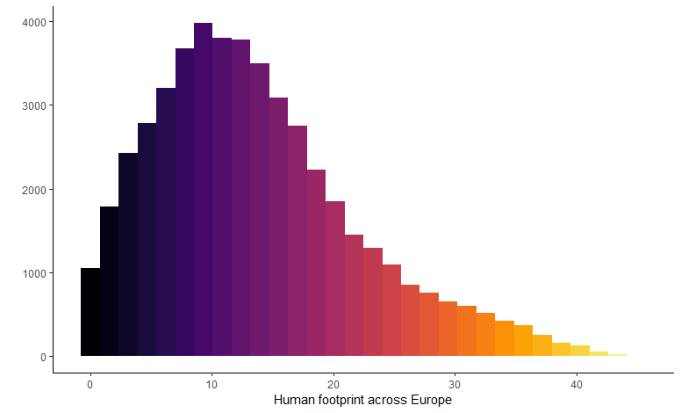

Slide 12
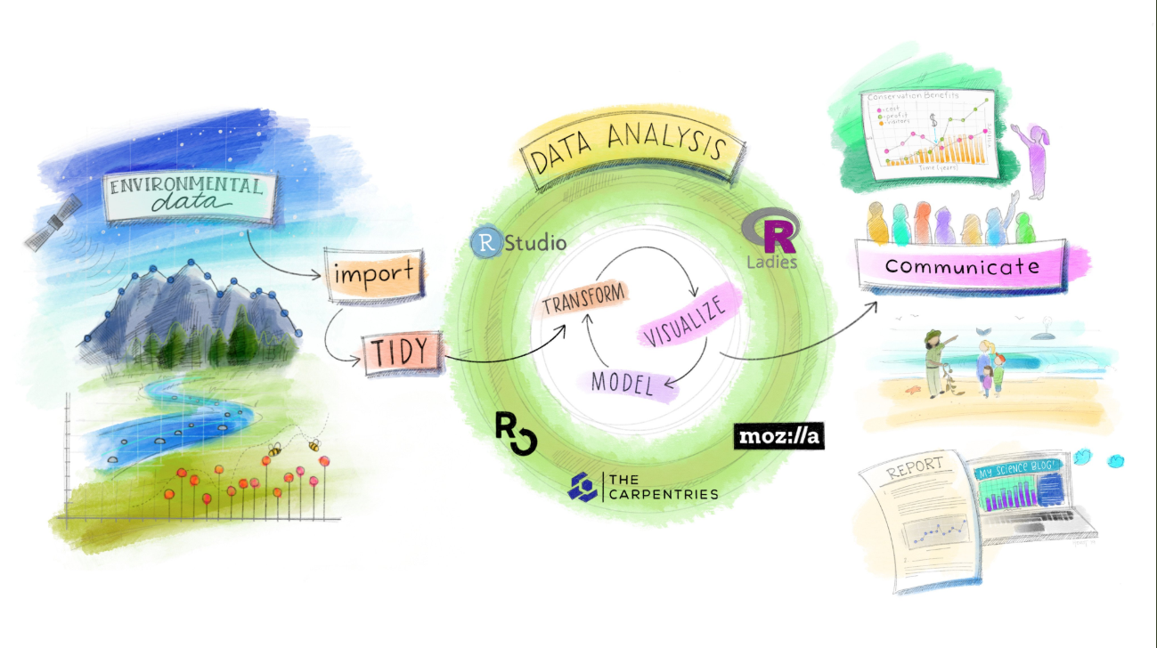

Slide 13
